Slide 1


Data Structure
Course Code : ENCS205
Dr Swati Gupta
Associate Professor, School of Engineering & Technology
K.R. Mangalam University
Unit 4 :Trees and Graphs
Notes:
New Courses replaced with New Programmes

Slide 2

Minimum Spanning Tree :KRUSKAL
Session 56
Introduction to Minimum Spanning Tree
Applications of Minimum Spanning Tree
Kruskal Algorithm
Kruskal Algorithm Example and Pseudo code
Brainstorming Session
Notes:
New Courses replaced with New Programmes

Slide 3
RECAP
Topological sorting is a dependency problem in which completion of one task depends upon the completion of several other tasks whose order can vary.
Topological sorting for Directed Acyclic Graph is a linear ordering of vertices such that for every directed edge u->v, vertex u comes before v in the order.
Notes:
New Courses replaced with New Programmes

Slide 4
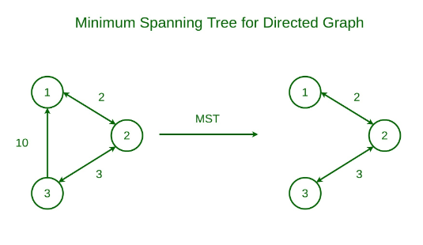
Spanning Tree of a Graph
Spanning Tree it is a subset of the edges of the graph that forms a tree (acyclic) where every node of the graph is a part of the tree.
Minimum Spanning tree has all the properties of a spanning tree with an added constraint of having the minimum possible weights among all possible spanning trees.
Notes:
New Courses replaced with New Programmes

Slide 5
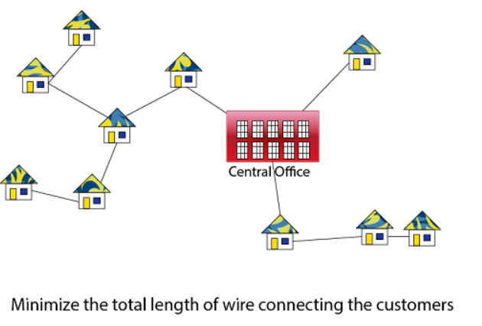
Applications of Minimum Spanning Tree
It helps in finding the route or paths on the map
For water-supply networks
Building a cable network that joins n locations with minimum cost
Notes:
New Courses replaced with New Programmes

Slide 6
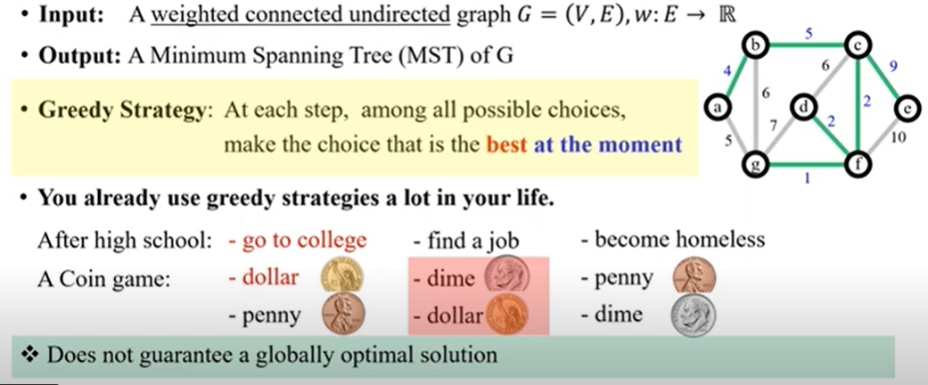
Minimum Spanning Tree Problem
Notes:
New Courses replaced with New Programmes

Slide 7
Minimum Spanning Tree
We can easily evaluate the minimum spanning tree from a graph with the help of two algorithms:
Kruskal’s Algorithm
2. Prim’s Algorithm
Notes:
New Courses replaced with New Programmes

Slide 8
Kruskal Algorithm
Kruskal’s Algorithm builds the spanning tree by adding edges one by one into a growing spanning tree.
Kruskal's algorithm follows greedy approach as in each iteration it finds an edge which has least weight and add it to the growing spanning tree.
Notes:
New Courses replaced with New Programmes

Slide 9
Algorithm for Kruskal Problem
Step 1: Sort the graph edges with respect to their weights.
Step 2: Start adding edges to the MST from the edge with the smallest weight until the edge of the largest weight.
Step 3: Only add edges which doesn't form a cycle , edges which connect only disconnected components.
Notes:
New Courses replaced with New Programmes

Slide 10

Implementing a Kruskal Algorithm
Kruskal MST
void kruskalMST() {
vector<Edge> result; // Store the resultant MST
vector<int> parent(V);
vector<int> rank(V, 0);
// Initialize each vertex to be its own parent
for (int i = 0; i < V; ++i) {
parent[i] = i;
}
// Sort all edges in non-decreasing order of their weight
sort(edges.begin(), edges.end(), [](Edge a, Edge b) {
return a.weight < b.weight;
});
Access the complete code here https://onlinegdb.com/B8CI9foV-n

Slide 11
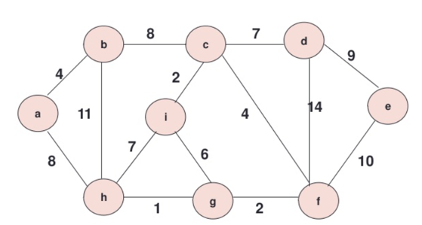
Practice Problem
Consider the following graph find the Minimum Spanning Tree (MST) using Kruskal Algorithm
Notes:
New Courses replaced with New Programmes

Slide 12
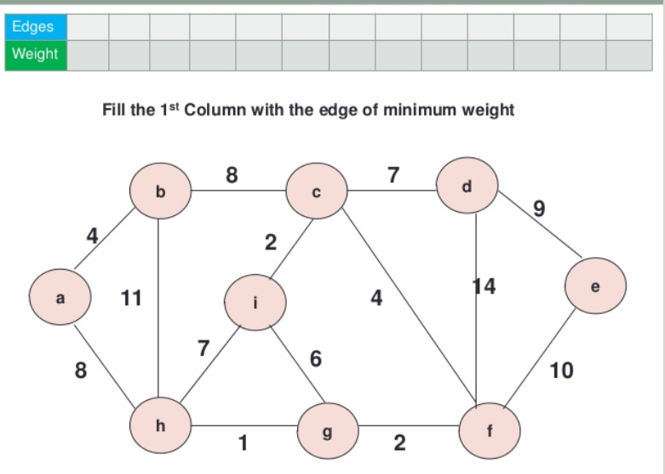
Practice Problem
Notes:
New Courses replaced with New Programmes

Slide 13
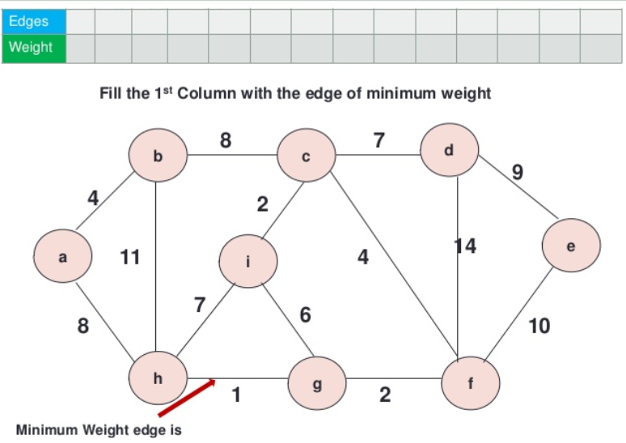
Practice Problem
Notes:
New Courses replaced with New Programmes

Slide 14
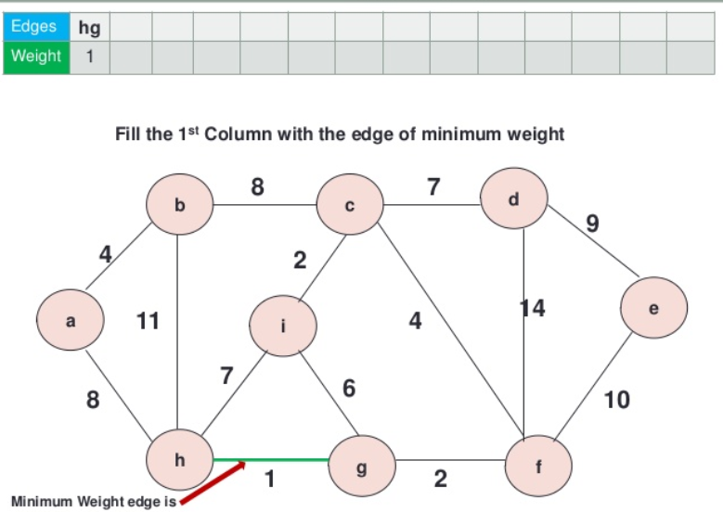
Practice Problem
Notes:
New Courses replaced with New Programmes

Slide 15
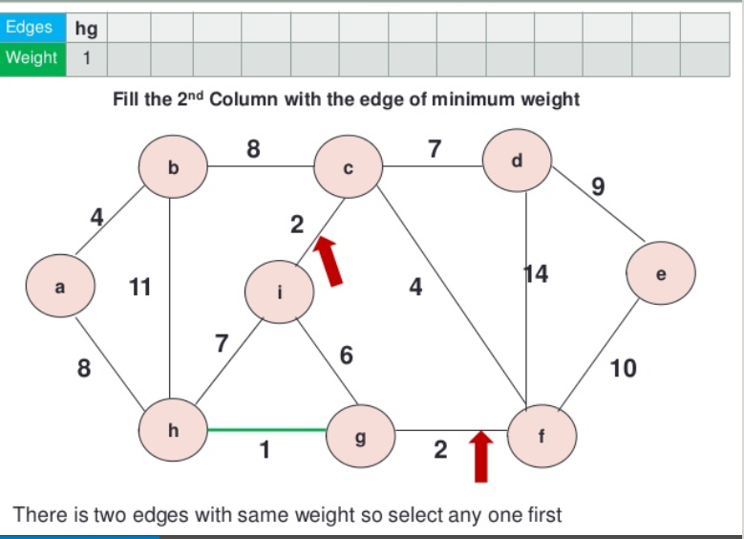
Practice Problem
Notes:
New Courses replaced with New Programmes

Slide 16
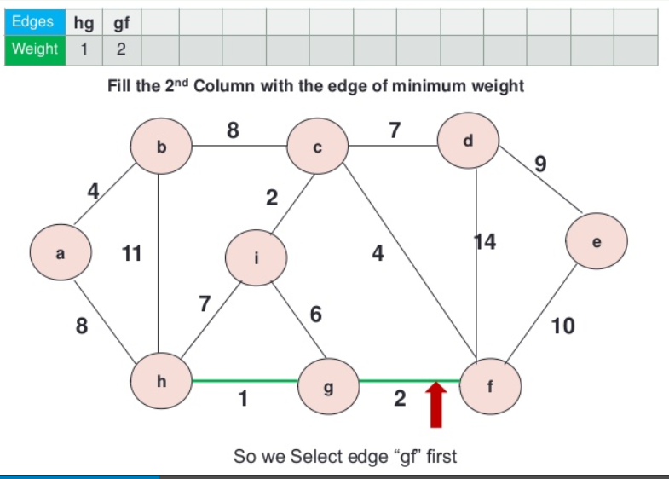
Practice Problem
Notes:
New Courses replaced with New Programmes

Slide 17
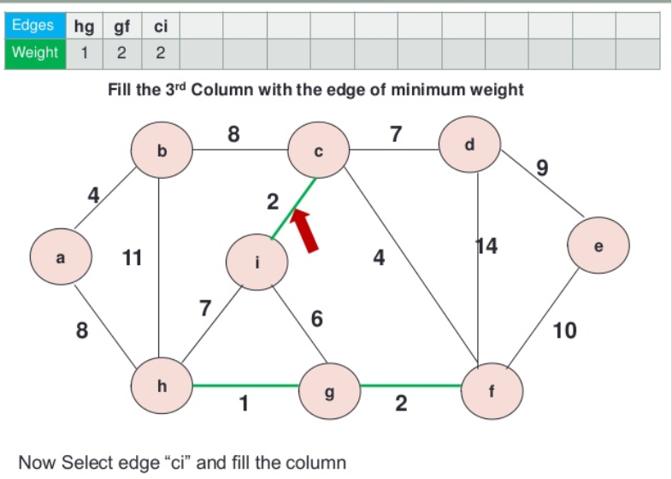
Practice Problem
Notes:
New Courses replaced with New Programmes

Slide 18
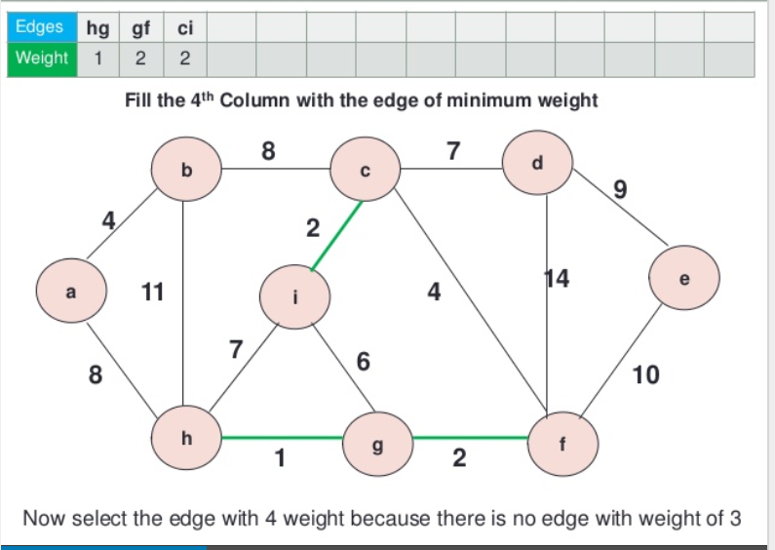
Practice Problem
Notes:
New Courses replaced with New Programmes

Slide 19
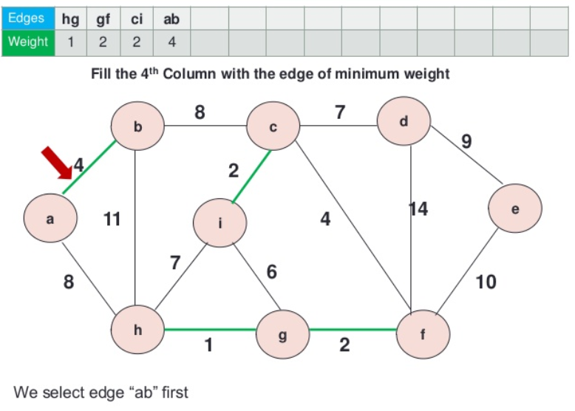
Practice Problem
Notes:
New Courses replaced with New Programmes

Slide 20
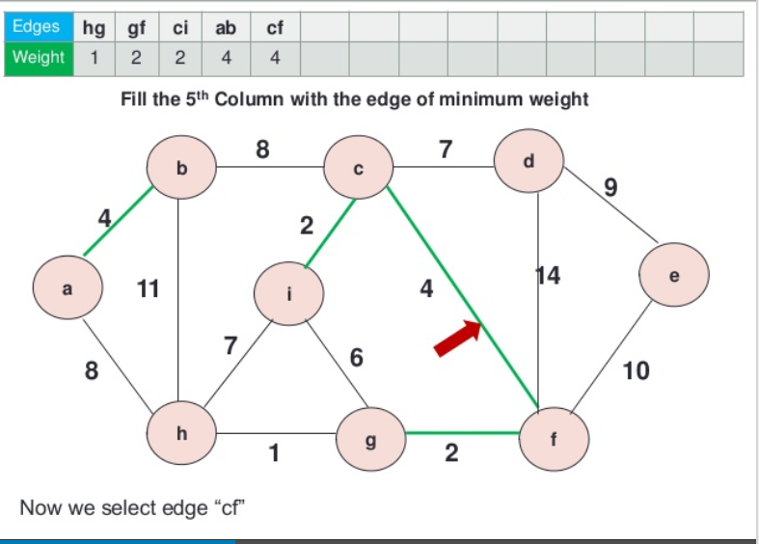
Practice Problem
Notes:
New Courses replaced with New Programmes

Slide 21
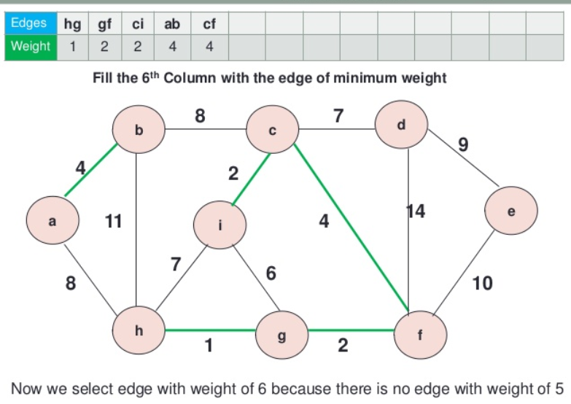
Practice Problem
Notes:
New Courses replaced with New Programmes

Slide 22
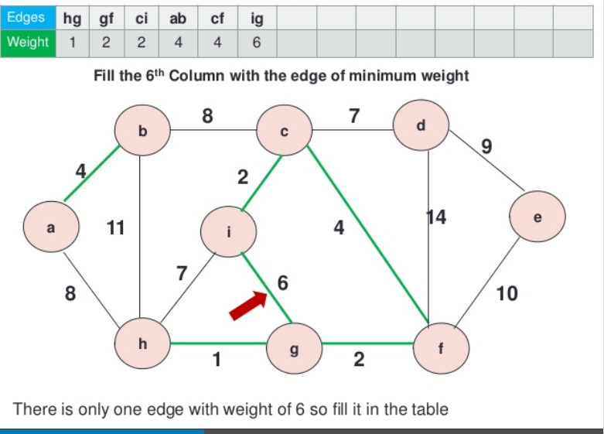
Practice Problem
Notes:
New Courses replaced with New Programmes

Slide 23
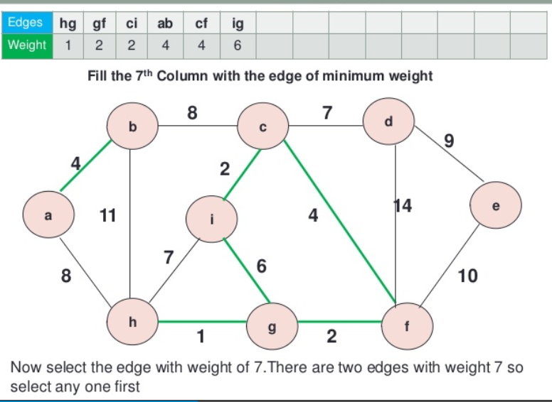
Practice Problem
Notes:
New Courses replaced with New Programmes

Slide 24
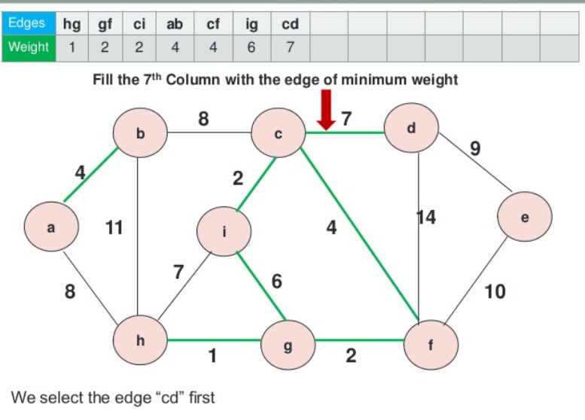
Practice Problem
Notes:
New Courses replaced with New Programmes

Slide 25
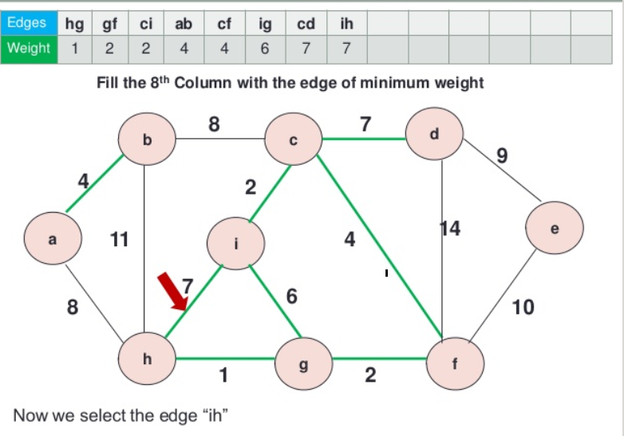
Practice Problem
Notes:
New Courses replaced with New Programmes

Slide 26
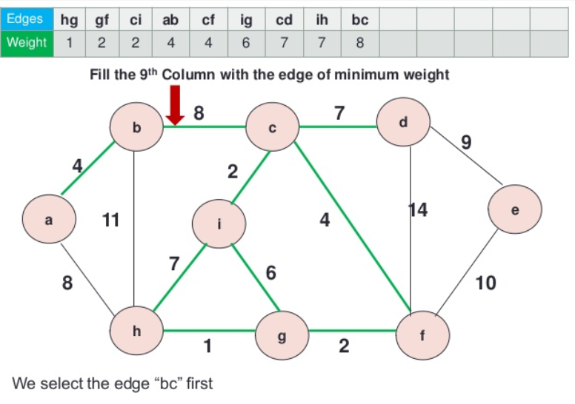
Practice Problem
Notes:
New Courses replaced with New Programmes

Slide 27
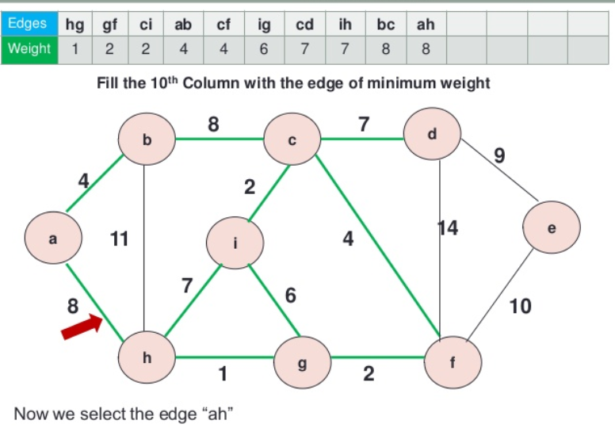
Practice Problem
Notes:
New Courses replaced with New Programmes

Slide 28
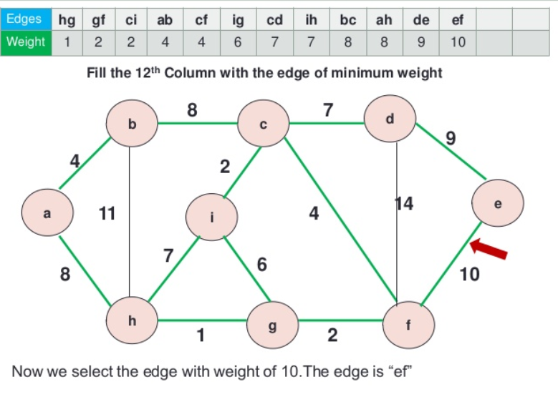
Practice Problem
Notes:
New Courses replaced with New Programmes

Slide 29
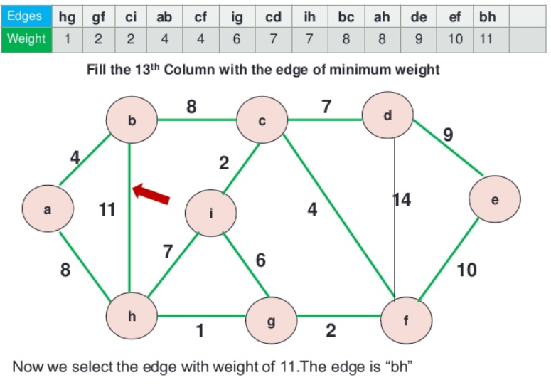
Practice Problem
Notes:
New Courses replaced with New Programmes

Slide 30
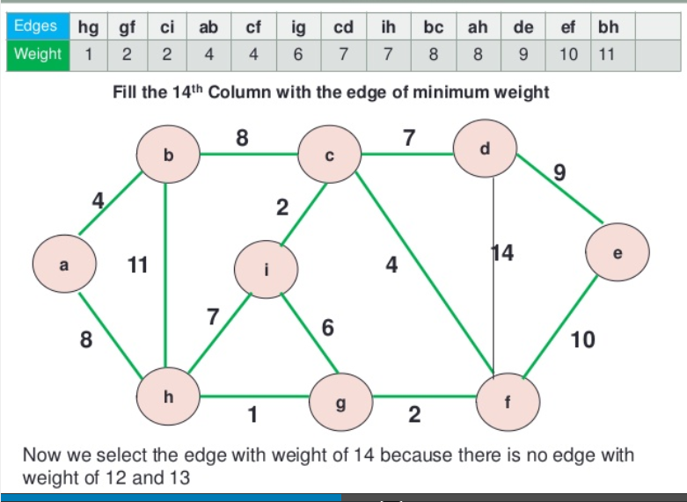
Practice Problem
Notes:
New Courses replaced with New Programmes

Slide 31
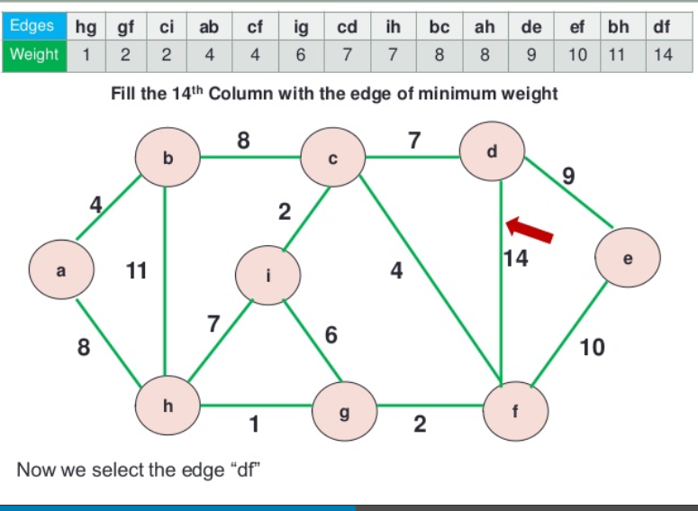
Practice Problem
Notes:
New Courses replaced with New Programmes

Slide 32
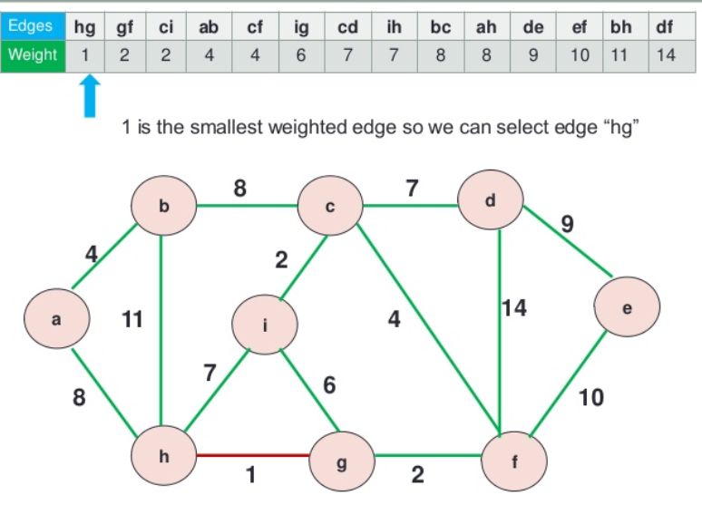
Practice Problem
Notes:
New Courses replaced with New Programmes

Slide 33
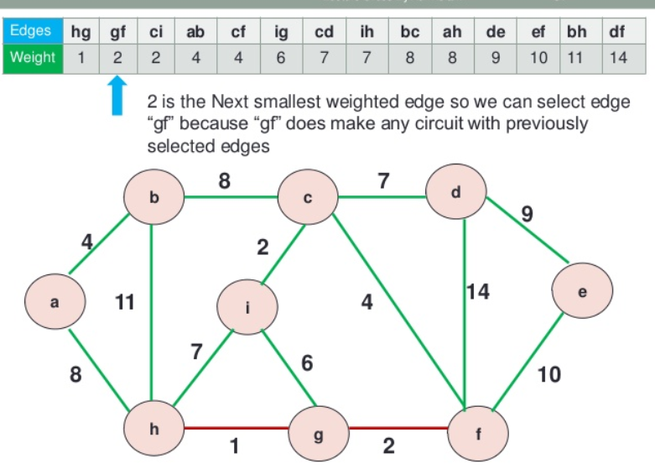
Practice Problem
Notes:
New Courses replaced with New Programmes

Slide 34
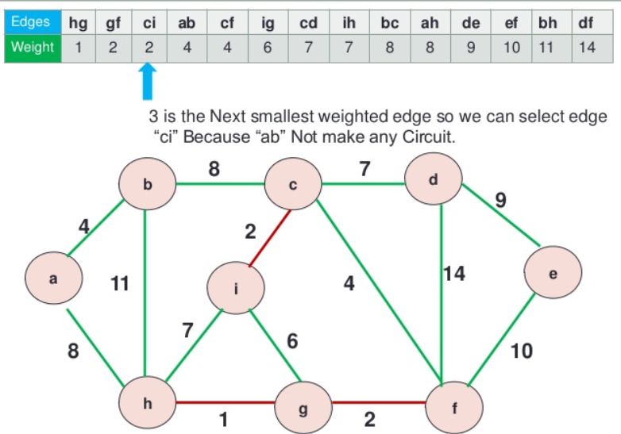
Practice Problem
Notes:
New Courses replaced with New Programmes

Slide 35
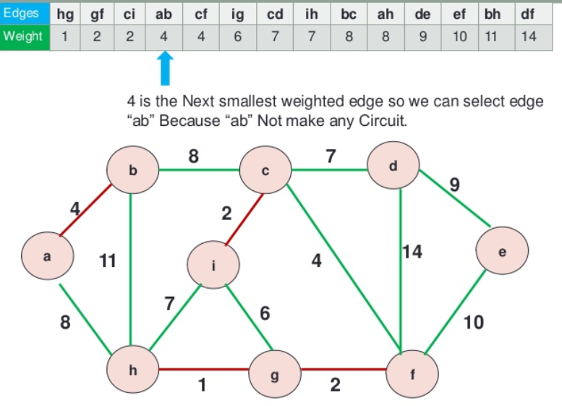
Practice Problem
Notes:
New Courses replaced with New Programmes

Slide 36
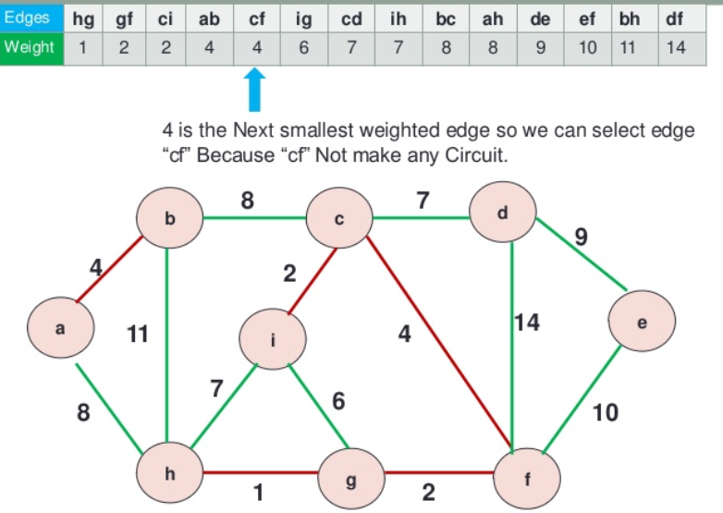
Practice Problem
Notes:
New Courses replaced with New Programmes

Slide 37
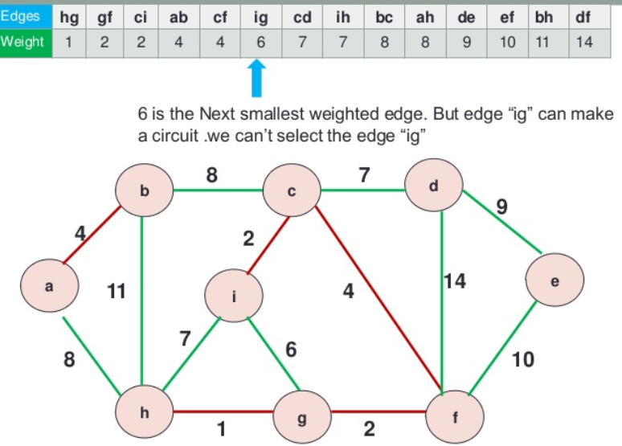
Practice Problem
Notes:
New Courses replaced with New Programmes

Slide 38
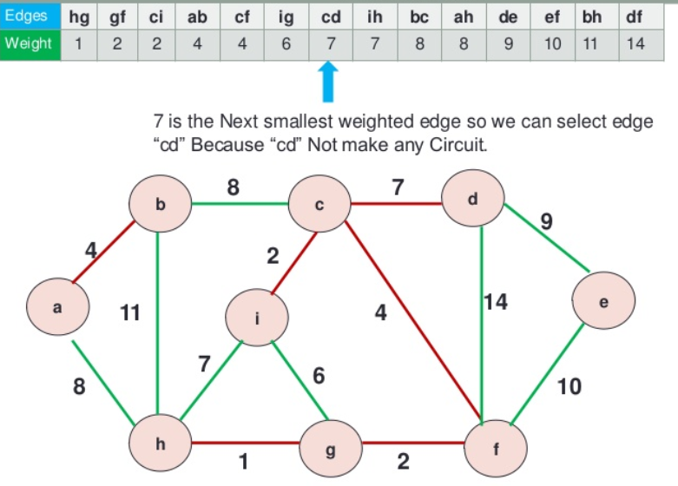
Practice Problem
Notes:
New Courses replaced with New Programmes

Slide 39
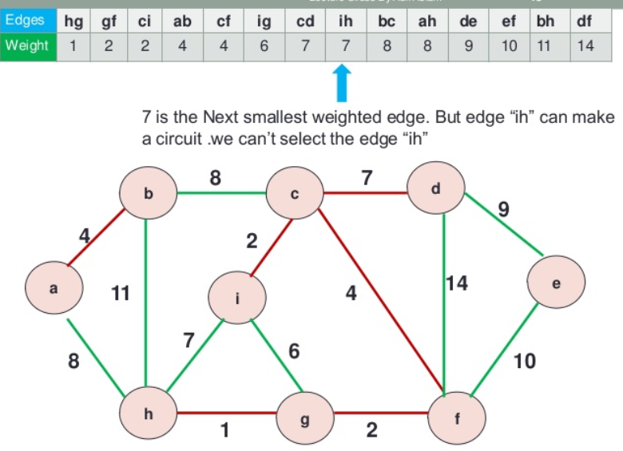
Practice Problem
Notes:
New Courses replaced with New Programmes

Slide 40
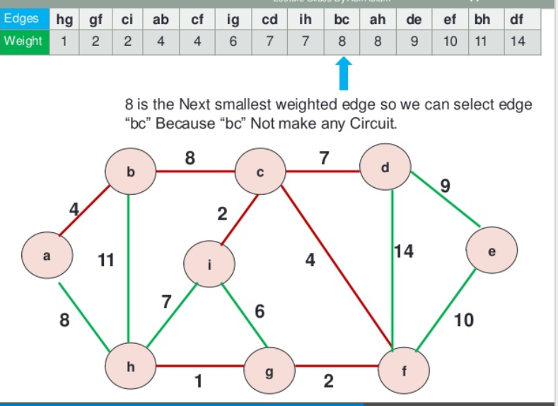
Practice Problem
Notes:
New Courses replaced with New Programmes

Slide 41
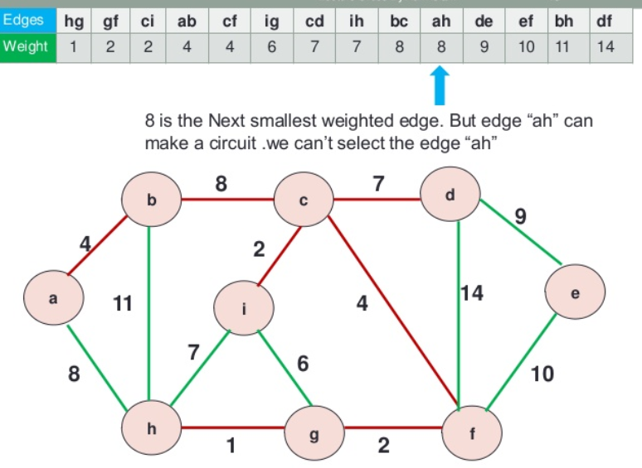
Practice Problem
Notes:
New Courses replaced with New Programmes

Slide 42
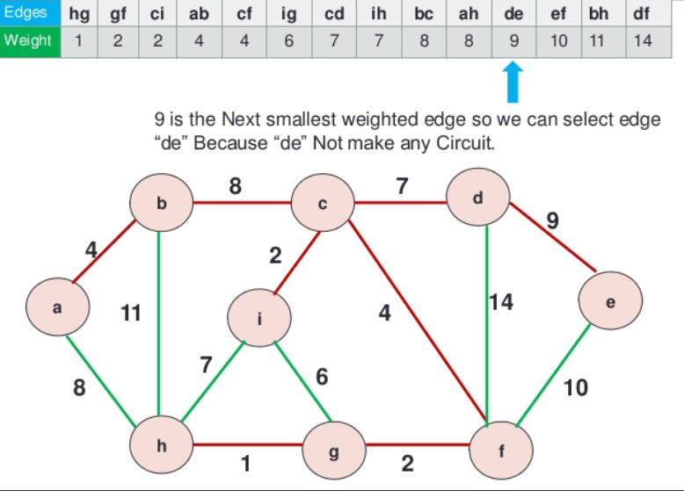
Practice Problem
Notes:
New Courses replaced with New Programmes

Slide 43
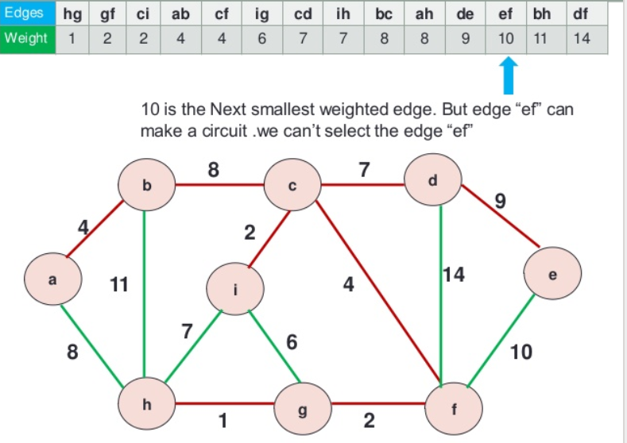
Practice Problem
Notes:
New Courses replaced with New Programmes

Slide 44
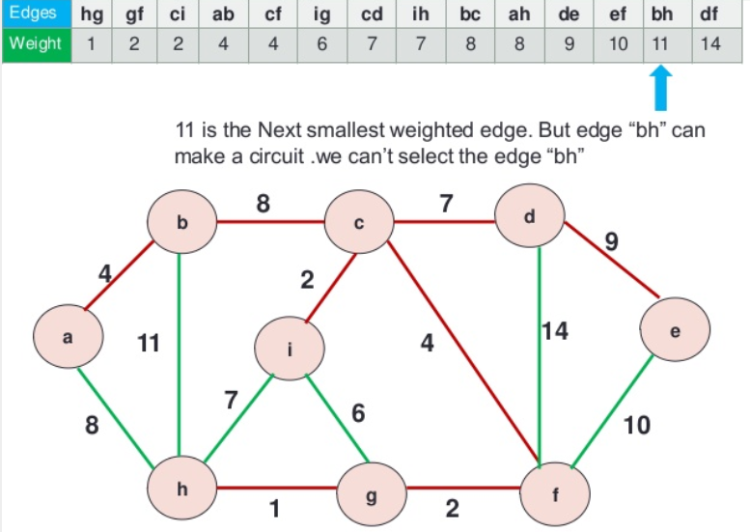
Practice Problem
Notes:
New Courses replaced with New Programmes

Slide 45
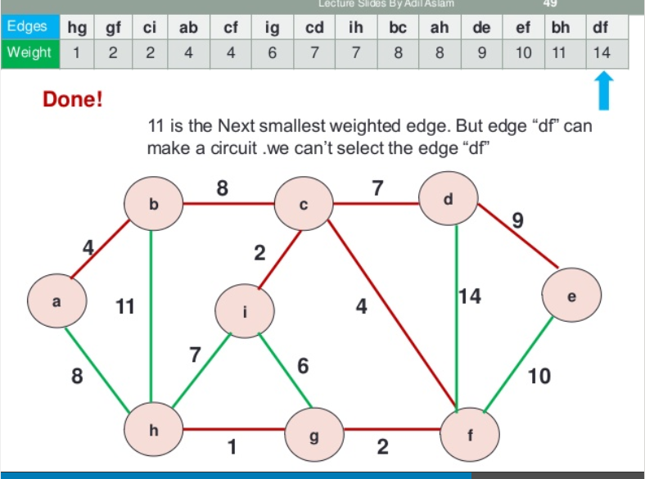
Practice Problem
Notes:
New Courses replaced with New Programmes

Slide 46
Practice Problem
Notes:
New Courses replaced with New Programmes

Slide 47
Pseudo code of Kruskal Algorithm
MST_Kruskal(Edges, V, E):
e=0, i=0
sum=0
Sort(Edges)
while(e<V-1):
u=Edges[i].u
v=Edges[i].v
if(Adding edge {u, v} do not form cycle):
Print(Adding edge {u, v} to MST)
sum+=Edges[i].weight
e+=1
i+=1
Notes:
New Courses replaced with New Programmes

Slide 48
Time and Space Complexity
Analysis of Kruskal Algorithm
Time complexity: O(E log E).
Explanation: Sorting all the edges requires O(E log E) time and after the sorting, the algorithm iterates through all edges, and the union function takes O(log V) time.
Overall complexity= O (E log E + E log V)
Space Complexity: O(E)
Notes:
New Courses replaced with New Programmes

Slide 49
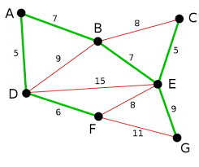
Exercise Problem
Consider the following Graph G and obtain the minimum spanning tree using Kruskal Approach
Notes:
New Courses replaced with New Programmes

Slide 50
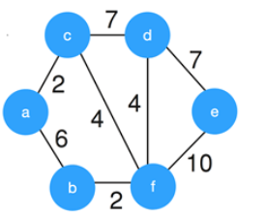
Test Your Knowledge
Consider the given graph. What is the weight of the
minimum spanning tree using the Kruskal’s algorithm?
a) 24 b) 23 c) 15 d) 19
Answer (D)
Notes:
New Courses replaced with New Programmes

Slide 51
Test Your Knowledge
2. Consider the following statements. S1. Kruskal’s algorithm might produce a non-minimal spanning tree. S2. Kruskal’s algorithm can efficiently implemented using the disjoint-set data structure. a) S1 is true but S2 is false b) Both S1 and S2 are false c) Both S1 and S2 are true d) S2 is true but S1 is false
Answer (D)
3. Which of the following is NOT a step in Kruskal's algorithm for finding the minimum spanning tree?
a) Initialize an empty graph as the minimum spanning tree b) Sort all the edges in ascending order of their weights c) Select the edge with the highest weight at each step d) Repeat until all vertices are included in the minimum spanning tree
Answer: (C)
Notes:
New Courses replaced with New Programmes

Slide 52
Test Your Knowledge
4. Which step ensures that Kruskal's algorithm does not form a cycle in the selected edges?
Sorting the edges based on weights
B) Selecting the edge with the smallest weight
C) Checking if adding the edge creates a cycle
D) Merging the sets of vertices connected by the edge
Answer: (C)
5. Consider a undirected graph G with vertices { A, B, C, D, E}. In graph G, every edge has distinct weight. Edge CD is edge with minimum weight and edge AB is edge with maximum weight. Then, which of the following is false? a) Every minimum spanning tree of G must contain CD b) If AB is in a minimum spanning tree, then its removal must disconnect G c) No minimum spanning tree contains AB d) G has a unique minimum spanning tree
Answer: (C)
Notes:
New Courses replaced with New Programmes

Slide 53
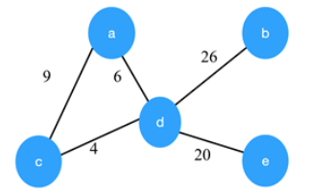
Test Your Knowledge
6. Consider the graph shown below. Which of the following are the edges in the MST of the given graph?
a) (a-c)(c-d)(d-b)(d-b) b) (c-a)(a-d)(d-b)(d-e) c) (a-d)(d-c)(d-b)(d-e) d) (c-a)(a-d)(d-c)(d-b)(d-e)
Answer (C)
Notes:
New Courses replaced with New Programmes

Slide 54
REVIEW
Spanning Tree it is a subset of the edges of the graph that forms a tree (acyclic) where every node of the graph is a part of the tree.
Kruskal’s Algorithm builds the spanning tree by adding edges one by one into a growing spanning tree.
Notes:
New Courses replaced with New Programmes

Slide 55
References
https://www.boardinfinity.com/blog/graphs-in-data-structure/.
https://www.geeksforgeeks.org/what-is-graph-data-structure/
https://www.tutorialspoint.com/data_structures_algorithms/graph_data_structure.html.
https://www.simplilearn.com/tutorials/data-structure-tutorial/graphs-in-data-structure
https://www.geeksforgeeks.org/applications-of-graph-data-structure/
https://www.upgrad.com/blog/graphs-in-data-structure/
https://www.youtube.com/watch?v=4IZ80K72OXo
Notes:
New Courses replaced with New Programmes

Slide 56
THANK YOU

